Slide 1
Implementation and Evaluation of Deep Neural Networks (DNN) on Mainstream Heterogeneous Systems
Junli Gu, Maohua zhu, zhitao zhou, feng zhang
Zhen lin, qianfeng zhang, mauricio breternitz
AMD (Research)
June 26, 2014
Junli.Gu@AMD.com
Notes:
DNN is becoming the leading direction in machine learning in the past two or three years.
Starting from April 2013, collaboration between AMD research and development team with experts in system, architecture and openCL. This is the first time we talk about DNN project in public.
AMD DNN project goal is to build DNN systems through AMD APU and GPUs. That can be applied to industry to address the h/w challenges.
We implemente and accelerate core DNN algorithms in OpenCL. Today I am sharing some initial results and our insights on systems.

Slide 2
Background
hidden1
What is a Deep Neural Network (DNN)?
3~8 hidden layers, millions to billions of parameters
DNN + Big Data is leading recent direction in machine learning
Rich Varieties of DNN Structures
MLP (Multi-level Perceptron)/ AutoEncoder
CNN (Convolutional Neural Network)
DBN (Deep belief network)/RBM (Restricted Boltzmann Machine)
DNN Applications
Speech Recognition
Image Classification/recognition/retrieval
Documentation retrieval, Handwriting recognition
OCR…
Industry Use of DNN
Google, Yahoo, Baidu, Alibaba, Tencent, iFlytek, Microsoft, Bank and Finance
hidden2
Input
hidden3
Output
neurons
weighted connection
Notes:
Since we have audience from system community, let me first introduce DNN a bit.

Slide 3
Motivation
DNN challenges hardware:
Computation Heavy, Memory Heavy and Parallel Execution
Fortunately, rich data/model parallelism of DNN
==> GPU passive hardware parallelism
==> Heterogeneous Platforms:
Clusters of CPU+GPU, or APU server?
Note: APU is a processor with both CPU and GPU on the same die.
Notes:
To explore which heterogeneous systems are the best efficiency motivates our project.
That saying when we map DNN to hardware systems, will it be good enough to have CPU and GPU connected through motherboard, or will it be better to have CPU and GPU more closely integrated? Say on the same chip. What is the major difference of the two systems?

Slide 4
CPU+GPU cluster
A node
Existing Platforms
CPU cluster (scale out)
CPU + GPU clusters (scale up + scale out)
Bottlenecks
GPU device memory size limitation for DNN data/model
Every 250M parameters require 1GB memory
Communication overheads are bottleneck
Intra node between CPU and GPU, intern node
GPU is big and power hungry, low density
GPU
PCIE
GPU
CPUs
GPU
GPU
Infiniband Connection
GPU
CPUs
PCIE
GPU
GPU
GPU
GPU
CPUs
PCIE
GPU
Google Brain’s 1000 processor system
Stanford Univ. Andrew Y. Ng etc., “Deep learning with COTS HPC systems”, International Conference on Machine Learning, 2013
GPU
GPU
Notes:
Comm overheads are hurting both performance and the scalability of the systems
when building servers and data centers, more limitation factors show up. For example, the physical space a cluster takes up and power consumption. We know, compare to small CPU, a GPU is like a big monster, and drains hundreds watt of power. This results in the cluster is low density,
Keep in mind these bottlenecks and let move to APUs

Slide 5
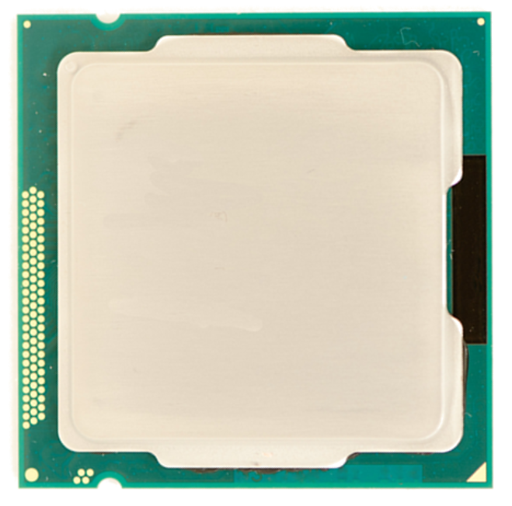
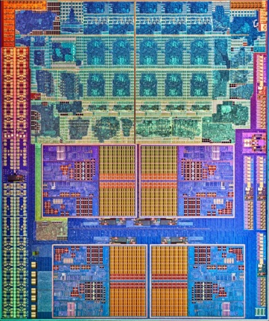
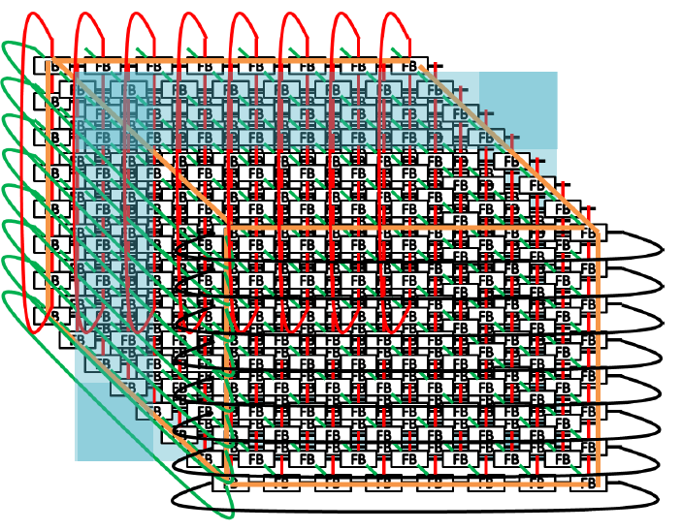
APU and APU Server
APU
In 2009, AMD launched the first chip integrated with both CPU and GPU
Programming through OpenCL
Architectural Advantages
Unified address memory: GPU CPU share very big memory
Very efficient data sharing: no data copy
Fully coherent memory
Sharing through pointers
APU Server
High density, low power data server
Customized fast FABRIC
In advance research on internal prototype
Shared Memory
GPU
CPU
HSA features
8x8x8=512 nodes
Credit: AMD Sea Micro
Notes:
APU enables close colloboration between CPU and GPU in finishing a task together, the nice thing of SPU is the same size and power consumption with CPU
This research is to evaluate the system effeciency in performance, power and performance per watt efficiency between those CPU +GPU clusters and APU servers. and provide insights how to build the APU server as future product

Slide 6
Some quick take aways
CPU+GPU cluster gets 2x speedup with 6x more power
2.4 APUs can achieve the same performance with 2.5x less power.
APUs can be integrated as high density, power efficient data centers to reduce complexity and cost.
Notes:
What we found out through our experiments are:
Those are the major take aways I hope
5 min

Slide 7
Outline
Background and Motivation
DNN Algorithm Architectures
MLP (Multi-Layer Perceptron )
Autoencoder
Evaluation on Multiple Platforms
Bottleneck Analysis
Conclusions and Next Plan
Notes:
Now let’s introduce the two of the DNN kernels we implement.

Slide 8
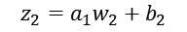

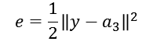
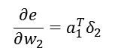
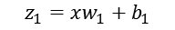

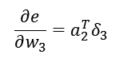
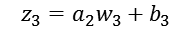
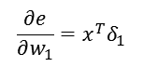

DNN algorithm architecture 1– MLP
MLP (Multi-Layer Perceptron )
Speech recognition
Layers of matrix multiply + non-linear functions
Compute Patterns
Layers of matrix multiplication
Reflects most DNN compute-intensive
CPU prepares data, GPU computes
MLP Structure
Forward/Backward Propagation
9304
Output
$$z_{1}=xw_{1}+b_{1}$$
$$z_{2}=a_{1}w_{2}+b_{2}$$
$$z_{3}=a_{2}w_{3}+b_{3}$$
2048
$$a_{1}=f(z_{1})$$
$$a_{2}=f(z_{2})$$
$$a_{3}=f(z_{3})$$
2048
Adjacent layers are fully connected
Parameter space:
44 million
(layer size: 1k-2k-2k-2k-2k-2k-2k-2k-2k-9k)
2048
error
Hidden layers
2048
$$e=\frac{1}{2}{\left\|y−a_{3}\right\|}^{2}$$
2048
2048
$$δ_{1}=w_{2}^{T}δ_{2}.∗f^{′}(z_{1})$$
$$δ_{2}=w_{3}^{T}δ_{3}.∗f^{′}(z_{2})$$
$$δ_{3}=−\left(y−a_{3}\right).∗f^{′}(z_{3})$$
Input
2048
$$\frac{∂e}{∂w_{1}}=x^{T}δ_{1}$$
$$\frac{∂e}{∂w_{2}}=a_{1}^{T}δ_{2}$$
$$\frac{∂e}{∂w_{3}}=a_{2}^{T}δ_{3}$$
1100
Notes:
Mlp refers to multi…it is a classical neural network model

Slide 9
DNN algorithm architecture 2–AUtoencoder
Autoencoder + L-BFGS Training
Used for pre-training (Hinton et al, 2006)
Semantic retrieval (Krizhevsky et al, 2011)
L-BFGS good scalability (Le et al, 2011 )
Compute Patterns
A mix of CPU compute with GPU compute
Frequent CPU-GPU interactions and data transfers
A good fit to leverage APU advantages
Autoencoder Structure
L-BFGS Training Algorithm
Reconstruction
Layer
Forward Propagation
Input Layer
Output Code
Cost and Gradients
GPU
1 Encode the input and then reconstruct the code for cost computing
Back Propagation
L-BFGS
Compute
New Direction
Y
Meet line search Condition?
N
2 Parameter space:
25 million
(layer size: 3k-6k-1k-6k-3k)
Get Cost and Gradients
CPU
Try New Step Length
Notes:
8 min

Slide 10
Outline
Background and Motivation
DNN Algorithm Architectures
Evaluation on Multiple Platforms
Implementation on APUs and GPUs
Performance/power/perf_per_watt comparison
Bottleneck Analysis
Conclusions and Next Plan
Notes:
In this section I am going to introduce the evaluation results on GPU and APUs. And provide a quantitive comparision between perf. power and perf per watt ratio.

Slide 11
Evaluation methodology and platforms
Implementations based on commercial BLAS libraries
Mainstream X86 CPUs: C++ & math library
AMD APUs & GPUs: OpenCL & CLAMDBLAS
Mainstream GPU: CUDA C & CUBLAS (for competitive purposes)
Platforms
 | Device Category | Device Name | Throughput (GFLOPS) | Price (RMB) | TDP (Watt) | CPU version | AMD OCL version | CUDA version | Note
 | CPU | Mainstream x86 | 848 | 2240 | 84 | √ | √ |  | Realtime power traces
 | APU series | AMD APU A10-7850k | 856 | 1299 | 95 |  | √ |  | Realtime power traces
 |  | Mainstream x86 SOC | 848 | 2240 | 84 |  | √ |  | Realtime power traces
 | Customer-end GPU | AMD HD7970 | 3788.8 | 2000 | 250 |  | √ |  | TDP used
 |  | Mainstream GPU | 3977 | 3799 | 250 |  | √ | √ | TDP used
Notes:
CPU version, CUDA version, OCL version are all developed by AMD for peer to peer benchmark comparison, due to resource limitation, can NOT guarantee the code is fully optimized, this is also next direction
Mainstream x86 SOC to the GPU on the soc
Current testing platform is only on one single platform.
OpenCL is able to run on all platforms , but for competitive purposes, we use the C abd Cuda version for our competetor’s CPU and GPUs.

Slide 12
Evaluation methodology and platforms-Cont.
Evaluation results indicate per-unit training speed
CNN not tested as work still under development
MLP and Autoencoder tested initial results
DNN model parameters and mini-batch size align with Internet industry
Single-node results presented
Further (ongoing) optimizations
Notes:
Before I show the results, let me clarify that
Initial results, not with our full optimizations. Just to compare

Slide 13
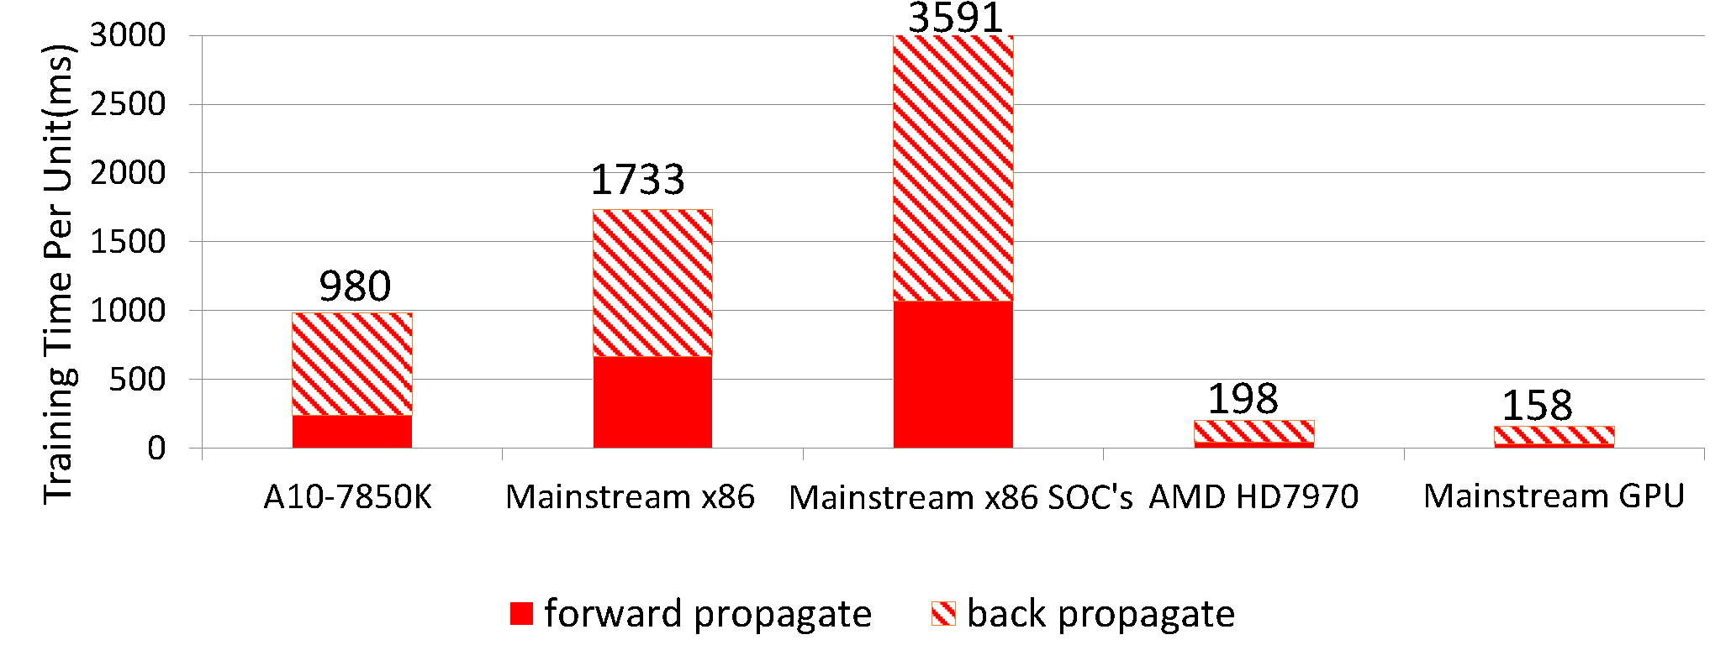
MLP Model(voice recognition)
Kaveri 95w v.s. Mainstream x86
1.8x speedup
Kaveri 95w v.s. Mainstream x86 SOC’s
3.7x speedup
Mini-batch size: 1024
CPU prepares data, GPU computes
Note: CLAMDBLAS offers an architecture-aware optimization tool called clAmdBlasTune. Make sure to tune it the first time to run on a processor.
Notes:
Doubt clAMDBlas performance lower than Mainstream GPU causing dGPU result lower performance
APU compared to GPU is about 5x to 6x slower. As we mention before, GPU is 10x more bigger and consumes more power.
9 ~10 minutes

Slide 14
PERFORMANCE/POWER/PERF_PER_WATT
APU achieves the highest Perf./watt
Eg. 1.2x compared to GPU
GPU achieves 5x perf. with 7x power
CPU gets 60% perf. with 1.9x power
Notes:
In order to provide a systematic comparison, we list a more comprehensive comparison on this slide.
X axis shows…different platforms
Y axis on the left shows the perf. normalized to APU

Slide 15
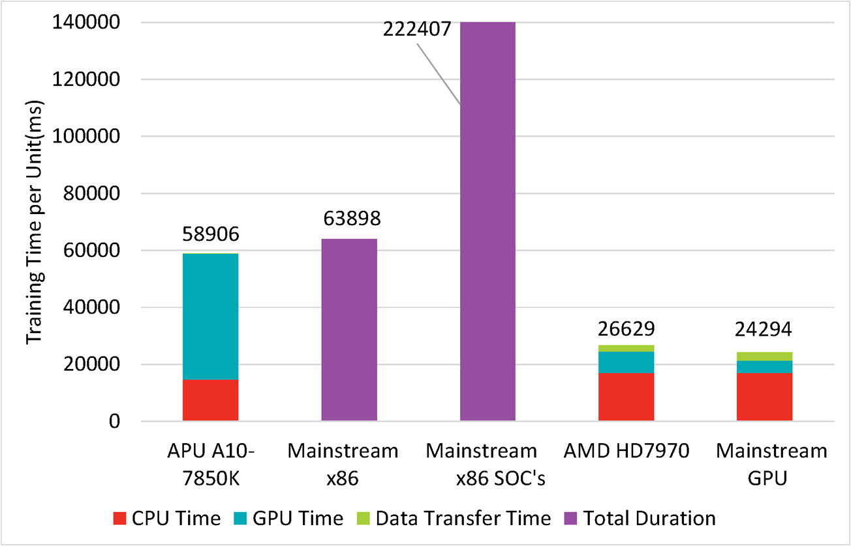
Autoencoder (image and document retrieval)
Algorithm is mix of
CPU+GPU compute
APU v.s. Mainstream x86
8% slow down
APU v.s. Mainstream x86 SOC’s
3.8x speedup
The larger the batch size is, the bigger advantage APU presents.
Data: CIFAR10, Mini-batch size: 2048
CPU: L-BFGS; GPU: Autoencoder forward and backward propogation
Notes:
11-12 minutes

Slide 16
PERFORMANCE/POWER/PERF_PER_WATT
APU achieves the highest Perf./watt
Eg. 2x compared to dGPU
GPU achieves 2x perf. with 5x power
CPU gets 90% perf. with 1.4x power
Notes:
Larger batch size means heavier matrix multiplication workload.

Slide 17
Real CASE training
MINIST Training through MLP Model
Handwritten digits , 60000 images
Mini-batch size 1024, 200 epochs
Accuracy 97% with random weights
Accuracy 98% with pre-trained weights
 |  | APU A10-7850 | GPU HD7970 | GPU vs. APU
Training Process | Time | 362 second | 192 second | 1.9x speedup
 | Average Power | 47 Watt | 250 Watt | 5.3x power
 | Energy | 17k Joule | 40k Joule | 2.4x energy
Predicting Process | Time | 8.1 second | 3.5 second | 2.3x speedup
 | Average Power | 37 Watt | 250 Watt | 6.8x power
 | Energy | 300 Joule | 875 Joule | 2.9x energy
Notes:
The previous slides show the per unit training speed. Now let’s take a look of real case
We show energy here because green computing is also critical metrix these days.
From this chart, we ca
n see APU server can be used to build power efficient servers.
13 minutes

Slide 18
Outline
Background and Motivation
DNN Algorithm Architectures
Evaluation on Multiple Platforms
Bottleneck Analysis
Conclusions and Next Plan
Notes:
Next I am going to go through bottlebeck analysis very quickly and share some of the OpenCL implementation experiences.

Slide 19
DNN Performance bottlenecks
DNN is usually converted to Matrix Multiplication, which consumes major part of time.
People use BLAS libraries provided on commercial processors.
Weight matrix is transposed during back propagation.
Flipped between row manner and column manner between fprop and bprop.
Data transfers between CPU and GPU can consume most of time, especially for large images.
Task assignment: CPU prepares the data, GPU computes
APU can remove the overheads through zero-copy technique

Slide 20
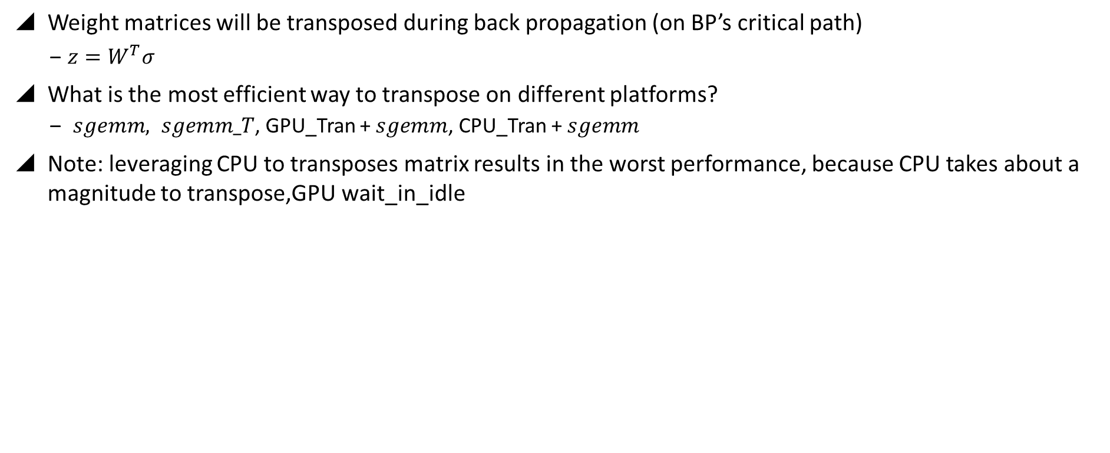
Further analysis-weight matrix transpose
Weight matrices will be transposed during back propagation (on BP’s critical path)
$z={W^{T}σ}^{}$
What is the most efficient way to transpose on different platforms?
$sgemm, sgemm_T$, GPU_Tran + $sgemm$, CPU_Tran + $sgemm$
Note: leveraging CPU to transposes matrix results in the worst performance, because CPU takes about a magnitude to transpose,GPU wait_in_idle
Platforms | AMD GPU FX8320+HD7970 | FX8320+Mainstream GPU | AMD APU A10-7850K
sgemm | 8.62ms | 6.09ms | 53.26ms
sgemm_T | 17.69ms | 6.31ms | 83.3ms
GPU Tran + sgemm | 9.56ms | 6.34ms | 55.46ms
CPU Tran + sgemm | 55.88ms | 67.46ms | 86.8ms
√
√
√
Micro benchmark: transpose 2kx2k matrix A and multiply $A^{T}$*B

Slide 21
Further analysis-Data transfer overheads
Data transfer overheads between CPU and GPU have been pointed out(A. et al., 2013) as the bottleneck
of DNN acceleration.
First, we use autoencoder to quantify the data transfer overheads.
Data transfer time increases linearly with data sizes. It is very difficult to train real world size images without removal of this bottleneck.
40% time is to move data, for 48x48 RGB images
Data Transfer Time %
Data transfer overheads on CPU + Mainstream GPU, one forward prop. and backward prop.
Notes:
Autoencoder training process involves frequent transfers of large amount of weight and gradients between CPU and GPU.

Slide 22
Data transfer overheads
How to avoid data copy through the zero-copy technique on APUs?
APU: Zero-copy improves performance by 10%
GPUs: Zero-copy degrades performance by 3.5x for AMD HD7970 and 8.7x for Mainstream GPU.
Zero-copy technique:
APUs: CPU and GPU share the same piece of memory, efficient
GPUs: GPU accesses host memory through PCIe, slow
Experiment design:
CPU initializes 2kx2k matrixes
(A, B), GPU performs C=A*B
Matrix multiplication performance comparison among copy and zero-copy
Notes:
The zero-copy technique refers to allocate host (CPU) a memory object but allow GPU to access it directly without the copy process.
APUs leverages zero-copy mechanism naturally because CPU and integrated GPU actually share the host memory.
18 min

Slide 23
Conclusions-APU server advantages
Based on autoencoder results
2.4x speedup
6x more power
Cluster of CPU + GPU
2.4 APUs can achieve similar performance with ~2.5x less power
2.5x higher performance given the same power budget
AMD APU Server
APU server achieves the same performance with ~1.8x less dollars
TCO (Total cost ownership)
APU servers remove GPU’s device memory limitation and data transfer bottleneck, which fit better for Big Data inputs
Architectural Advantages
HEADER
Notes:
APU server can achieve the same performance with approximately 1.8x less dollars
Assume the same cost for memory, motherboard and interconnects
Architectural advantages: APUs have very large unified address space
Remove GPU's device memory limitation and data transfer bottleneck, which suits better for Big Data inputs.

Slide 24
next PLAN-AMD solutions
H/W solutions: Parallel implementation on systems and system level evaluation
CPU + GPUs cluster
APU server
S/W solutions: OpenCL Implementation of DNN specific kernels
OpenCL implementations and optimizations, applicable to general heterogeneous platforms
Set up real world application scenarios with external company’s involvement and apply AMD solutions to industry

Slide 25
Disclaimer & Attribution
The information presented in this document is for informational purposes only and may contain technical inaccuracies, omissions and typographical errors.
The information contained herein is subject to change and may be rendered inaccurate for many reasons, including but not limited to product and roadmap changes, component and motherboard version changes, new model and/or product releases, product differences between differing manufacturers, software changes, BIOS flashes, firmware upgrades, or the like. AMD assumes no obligation to update or otherwise correct or revise this information. However, AMD reserves the right to revise this information and to make changes from time to time to the content hereof without obligation of AMD to notify any person of such revisions or changes.
AMD MAKES NO REPRESENTATIONS OR WARRANTIES WITH RESPECT TO THE CONTENTS HEREOF AND ASSUMES NO RESPONSIBILITY FOR ANY INACCURACIES, ERRORS OR OMISSIONS THAT MAY APPEAR IN THIS INFORMATION.
AMD SPECIFICALLY DISCLAIMS ANY IMPLIED WARRANTIES OF MERCHANTABILITY OR FITNESS FOR ANY PARTICULAR PURPOSE. IN NO EVENT WILL AMD BE LIABLE TO ANY PERSON FOR ANY DIRECT, INDIRECT, SPECIAL OR OTHER CONSEQUENTIAL DAMAGES ARISING FROM THE USE OF ANY INFORMATION CONTAINED HEREIN, EVEN IF AMD IS EXPRESSLY ADVISED OF THE POSSIBILITY OF SUCH DAMAGES.
ATTRIBUTION
© 2013 Advanced Micro Devices, Inc. All rights reserved. AMD, the AMD Arrow logo and combinations thereof are trademarks of Advanced Micro Devices, Inc. in the United States and/or other jurisdictions. Other names are for informational purposes only and may be trademarks of their respective owners.

Slide 26
Back up slides

Slide 27
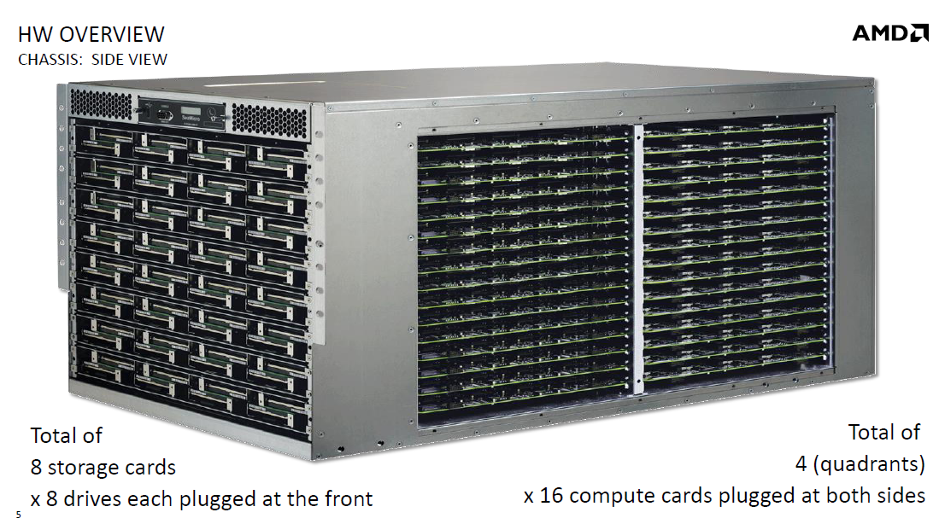

Slide 28
System overview
APU
Arrow thickness
→bandwidth
GPU compute accesses must stay coherent
Invalidation traffic
Direct-access bus
(used for graphics)
Notes:
In order to stay coherent need to put all GPU coherent requests through directory
Very high bandwidth
Arrow thickness

Slide 29
System overview
GPU
Very high bandwidth:
L2 has high miss rate
Notes:
CU = streaming multiprocessor
Talk more about i-fetch/register file/scratch pad

Slide 30
SeaMicro

